Slide 1

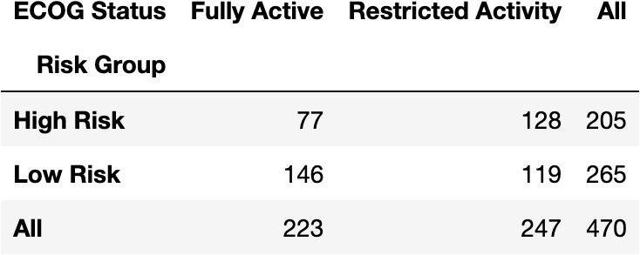
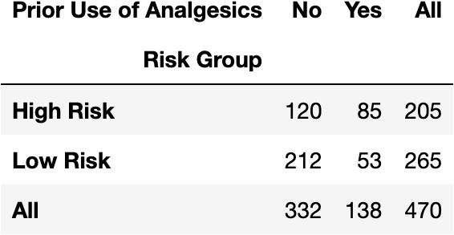
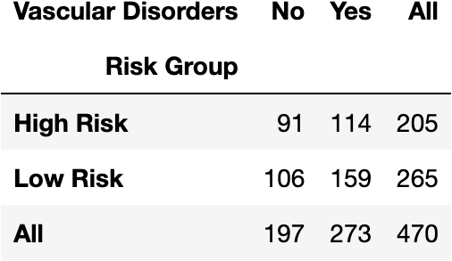
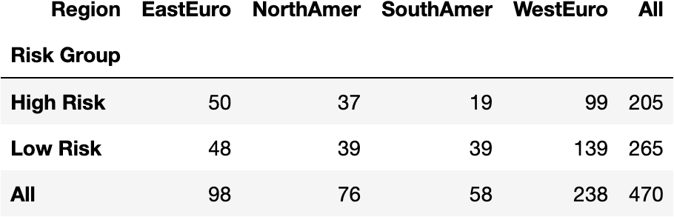
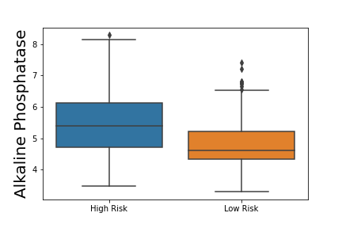
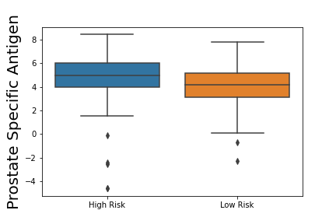
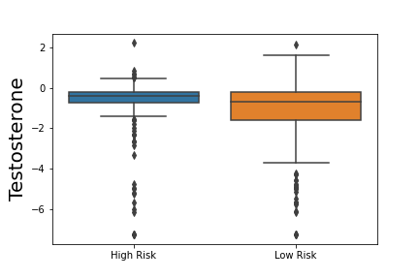
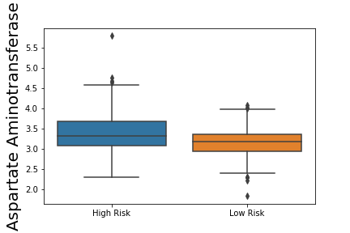
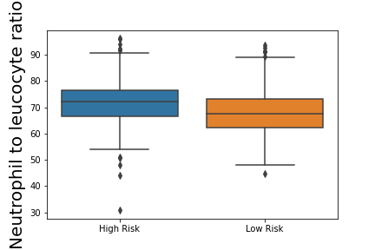
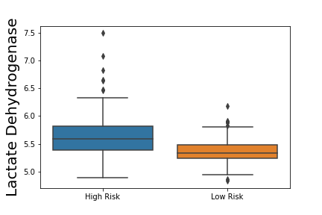
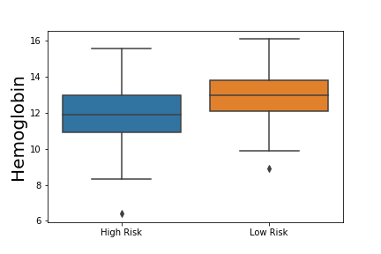
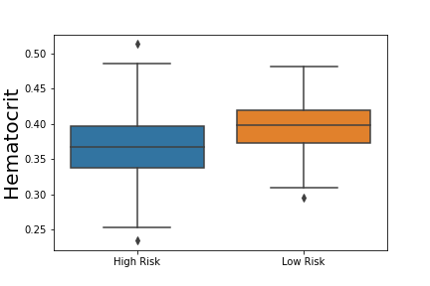
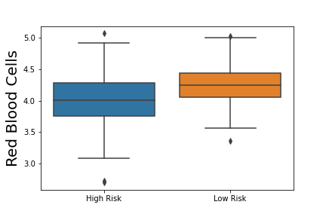
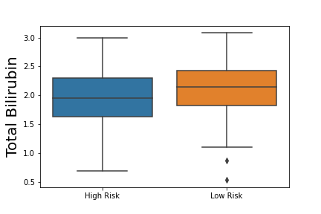
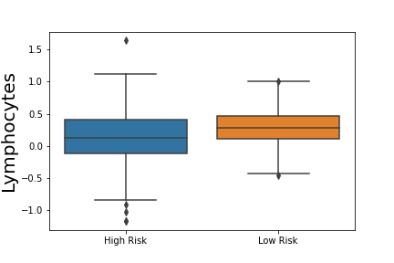
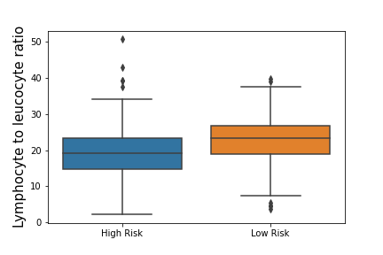
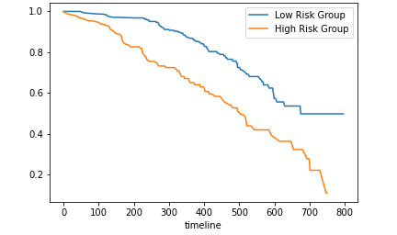
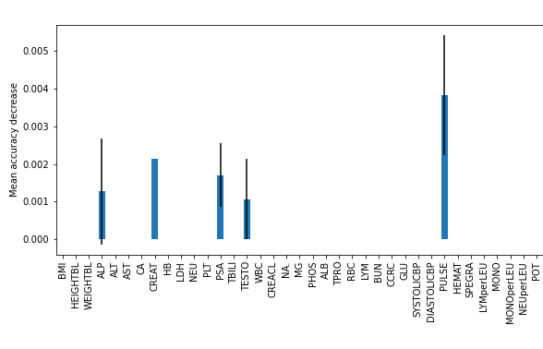
Predicting overall survival for patients with metastatic castration-resistant prostate cancer
Belal Elsiesy and Dr. Guanghua Xiao, PhD
Department of Bioinformatics, Southwestern Medical Center, Dallas, Texas
Introduction
Results
Conclusion
Prostate cancer (PCa) is the second most common cancer among men, accounting for 14.1% of new cancer cases and 6.8% of mortalities [2]. In its later stages, it progresses into castration resistance prostate cancer (CPRC), becoming resistant to androgen-deprivation therapy and other standard treatments.
The prognosis of CPRC is associated with multiple risk factors, including Eastern Cooperative Oncology Group(ECOG) patient performance status, bone pain, prostate-specific antigen(PSA) levels, and alkaline phosphatase(ALP) levels [3]. To build on these prognostic factors, prognostic predictive models have been developed, which analyzing patient data like treatments, laboratory values, vital signs, metastasis sites, and other information. One model developed in 2014 confirmed the previously known predictive factors (ECOG status, PSA, and ALP), while including disease site, lactate dehydrogenase(LDH), opioid analgesic use, albumin(ALB), and hemoglobin(HB) as new survival indicators[4].
Here, we present results of a new model created from phase 3 clinical trial data released by Project Data Sphere[1], a non-profit initiative that openly shares oncology data with researchers. The two goals of this model are to identify prognostic factors, confirming previously known predictors and uncovering new ones, and to accurately predict patient risk given this data.
Variable | Training Set | Testing Set
# of Patients | 470 | 476
Mean Survival Time | 648 | 372.5
Age
18-64 | 159 | 111
65-74 | 212 | 211
75+ | 99 | 154
ECOG Status
Fully Active | 223 | 220
Restricted Activity | 247 | 256
Status
Alive | 158 | 338
Dead | 312 | 138
Figure 2 – Significant binary and categorical variables (p < 0.0005 in chi-squared or fisher exact tests): Restricted activity correlated with high risk; 51% of patients with restricted activity were high risk, compared to 35% of fully active patients. Prior use of analgesics is correlated with high risk; 62% of patients who used analgesics were high risk, compared to 36% with patients who didn’t. Vascular disorders seem to be correlated with low risk, since 58% of patients with vascular disorders are low risk. High risk patients make up 30% of those in South America, 41% of those in West Europe, and approximately 50% of the patients in East Europe and North America.
The 2 goals of the model were achieved. First, the analysis and the model’s feature importance both confirmed known prognostic factors for CPRC and identified new predictors. They validated alkaline phosphatase (ALP), prostate specific antigen(PSA) and testosterone(TESTO), the three factors tested for in clinical practice, as the most important predictors of risk. Furthermore, the univariate analysis confirmed the same predictors as the 2014 model on this data; Eastern Cooperative Oncology Group status (ECOG), disease site, use of analgesics, lactate dehydrogenase (LDH), albumin (ALB), hemoglobin( HB), PSA, and ALP. The new predictors discovered in the analysis mostly fall into 3 categories. First, the immune and lymphatic system health (based on decreased lymphocytes, decreased lymphocyte to leucocyte ratio, and increased neutrophil to leucocyte ratio) is a predictor of patient risk. Also, vascular health and hematological labaratory values, such as decreased HB, hematocrit, or red blood cells) is shown to highly correlated with patient outcome. Lastly, kidney health, assessed through creatinine levels and decreased total bilirubin, is indicative of high risk. These predictive factors have been confirmed in other groups’ analyses of this dataset^{[1]}. Other predictive factors that don’t fall into these categories are aspartate aminotransferase(AST) , LDH, and region in the world. One issue with the analysis was that creatinine levels and pulse were important to the model but were not correlated with the patient risk variable. However, they may be correlated with other feature variables. Performing multivariate analysis may shed more light on these 2 variables. Overall, our analysis has led to a new understanding of the factors that influence patient survival for CPRC patients, essentially succeeding at our first goal.
The second goal of this model would be to accurately predict patient survival. Of all the models we tested, the random forest model performed the best, most likely due to its ensemble style, its proficiency in recognizing important factors, and its ability to deal with unbalanced datasets. As an ensemble model, the variety within the trees of the forest prevented overfitting, which was an issue with other more complex models. Also, because of the clear, clinically-tested predictive factors (ALP, TESTO, and PSA), the random forest excelled, recognizing these variables because of their high information gain. The different trees of the forest split on these variables, as suggested by the feature importance plot (Figure 6). Another reason the random forest likely excelled is because of its ability to work with unbalanced sets. The training and testing sets have the same number of patients but are vastly different in mean survival time. Thus, the random forest performed the best in dealing with the unbalanced risk groups. One of the worst performing models was the artificial neural network (ANN), which was outperformed by simpler traditional machine learning models. This is because deep learning models require large amounts of data, and the datasets used for training and testing had around 500 patients each.
Figure 1 – Dataset general information: The training and testing set are balanced in size, age distribution, and Eastern Cooperative Oncology Group (ECOG) performance status. However, they vary significantly in the target survival variables (time and death status). The training set has a significantly higher mean survival time (about 75% longer).
A
B
C
D
E
F
— High risk
— Low Risk
Future Directions
G
H
I
J
K
L
Utilize new understanding of risk factors for diagnosis and prognosis
Incorporate genomics data and pathology imaging into model given current research advances
Develop similar prognostic models for other types of cancer
Figure 3 – Significant continuous variables, p < 0.0005 (~0.05/101) from t-test: Figures A through F show variables that increased in the high-risk group, while Figures G through L show variables that decreased in the high risk group. Of the 6 variables that decreased, 3 were related to hematology, suggesting that blood health is an indicator of risk. Also, as seen in Figures A through C, the 3 diagnostic factors for prostate cancer increase with risk, confirming their validity in the dataset.
Literature Cited
Model | Prediction Accuracy (std)
Support Vector Machine (Default Parameters) | 63.36% (0.94%)
Support Vector Machine (Best Parameters: 'C': 10, 'gamma': 0.0001) | 71.31% (3.51%)
Logistic Regression | 79.66% (5.41%)
Random Forest (n estimators = 100) | 81.05% (7.44%)
Random Forest (n estimators = 300) | 81.45% (5.64%)
Artificial Neural Network (epochs=100) | 67.02% (9.19%)
Artificial Neural Network (epochs=350) | 69.15% (6.68%)
Artificial Neural Network (epochs=350, scaled data) | 72.55% (4.09%)
Artificial Neural Network (epochs = 350, scaled data, less complex model) | 72.13% (4.70%)
Figure 5 – Survival Analysis for Predicted Risk Groups from Random Forest Model (Independent Testing Set): The Kaplan Meier curve demonstrates a significant difference in survival for the risk groups (confirmed by the log rank test), indicating that it accurately predicted the groups. The high-risk group has lower survival.
Guinney, J., Wang, T., Laajala, T. D., Winner, K. K., Bare, J. C., Neto, E. C., Khan, S. A., Peddinti, G., Airola, A., Pahikkala, T., Mirtti, T., Yu, T., Bot, B. M., Shen, L., Abdallah, K., Norman, T., Friend, S., Stolovitzky, G., Soule, H., Sweeney, C. J., … Prostate Cancer Challenge DREAM Community (2017). Prediction of overall survival for patients with metastatic castration-resistant prostate cancer: development of a prognostic model through a crowdsourced challenge with open clinical trial data. The Lancet. Oncology, 18(1), 132–142. https://doi.org/10.1016/S1470-2045(16)30560-5
Sung, H, Ferlay, J, Siegel, RL, Laversanne, M, Soerjomataram, I, Jemal, A, Bray, F. Global cancer statistics 2020: GLOBOCAN estimates of incidence and mortality worldwide for 36 cancers in 185 countries. CA Cancer J Clin. 2021: 71: 209- 249. https://doi.org/10.3322/caac.21660
Hotte, S. J., & Saad, F. (2010). Current management of castrate-resistant prostate cancer. Current oncology (Toronto, Ont.), 17 Suppl 2(Suppl 2), S72–S79. https://doi.org/10.3747/co.v17i0.718
Halabi, S., Lin, C. Y., Kelly, W. K., Fizazi, K. S., Moul, J. W., Kaplan, E. B., Morris, M. J., & Small, E. J. (2014). Updated prognostic model for predicting overall survival in first-line chemotherapy for patients with metastatic castration-resistant prostate cancer. Journal of clinical oncology : official journal of the American Society of Clinical Oncology, 32(7), 671–677. https://doi.org/10.1200/JCO.2013.52.3696
Methods and Materials
Data: The patient data is from Project Data Sphere and is publicly available[1].
Calculating Risk: Using the death and time variables, we created a binary risk variable (either high or low risk). Any patient that survived longer than 2 years was considered low risk. Any patient who died in under 1 year was high risk. The rest of the patients were dropped from the analysis.
Univariate Analysis for Binary Variables: We created contingency tables between each variable and the risk group and then ran chi-squared test and fisher’s exact test on that table. After filtering the results of the tests for results with significance value less than ~0.05/101 (Bonferroni Correction), we got the most significant binary and categorical variables.
Univariate Analysis for Continuous Variables: For each continuous variable, we created box plots comparing the distribution of the value between both risk groups. Also, we ran t-tests between the risk groups to find the significance of the variable. Then, like with the binary variables, any variable with p-value less than 0.05/101 (because of the Bonferroni correction) was considered significant.
Traditional Machine Learning Models for Prediction: We ran each of the following models with the binary risk variable as the target and with 10-fold cross validation, adjusting the parameters to prevent overfitting. We ran a support vector machine (adjusting its C and gamma parameters based on a Grid Search), a logistic regression model, and a random forest model (adjusting the number of estimators in the forest).
Artificial Neural Network: We created a neural network with 2 inner layers, one with 101 neurons and the other 50 neurons. We ran this model, adjusting the number of epochs it ran for and whether the data was normalized. Then, we decided to create a simpler model with 50 neurons and 25 neurons on its inner layers, running it for 350 epochs with normalized data.
Survival Analysis: After comparing the accuracy of the models, we chose the best performing one, trained it on the entire training dataset, and predicted the risk group for an independent testing set. Then, we plotted the Kaplan Meier curves for that set with the model’s predicted groups, ran a log-rank test to analyze the results, and calculated the variable importance on the model to reveal the most important factors.
Pv = 1.6E-7
(Log rank test)
Acknowledgements
Figure 6 – Feature Importance for Final Random Forest Model: The feature importance plot for the final random forest was calculated based on permutations on the full model. The most important variables are alkaline phosphatase, creatinine, prostate specific antigen, testosterone, and pulse.
I would like to first express my gratitude to the wonderful STARS program staff of Dr. Joel Goodman, Lynn Tam, Maria Sandlin, Mary Leyendecker, Pearlie Crawford, and Kristie Conner for this great opportunity. Your work organizing and managing the events, seminars, and meetings didn’t go unnoticed, and I appreciate your availability and help during this virtual program.
I would also like to acknowledge Dr. Guanghua Xiao and Dr. Yang Xie for the opportunity to intern with and learn from them. I appreciate all the guidance and help from you, and all the techniques and analyses I’ve learned during this project. I look forward to continuing work with you both on the pediatric cancer awareness website and potentially returning in future summers.
Figure 4 – Model Performance on Training Set: The model’s prediction accuracies are the mean accuracies from the 10-fold cross-validation on the the training set. The best performing model was the Random Forest Model with 300 trees. The worst performing models were the default Support Vector machine and the unscaled Artificial Neural Network, which still didn’t perform as well as the other traditional machine learning models even with scaling.

